Slide 1


Slide 2

Agenda
Problem Statement
Data Description
Objective Key Metrics and Visualizations
Subjective Question for Insights

Slide 3
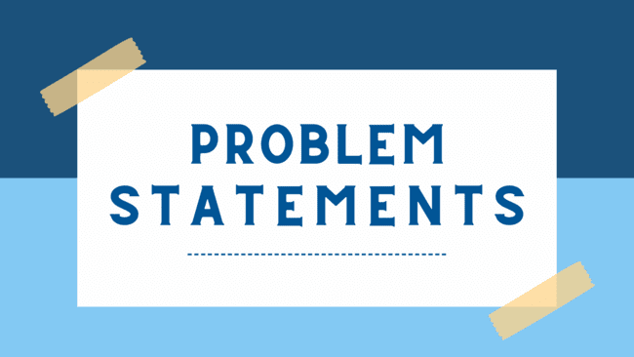
Problem Statement
You are hired as a data analyst at Chinook,
and your objective is to analyze music
record sales data to gain insights and make
recommendations for the company's strategy
in the physical music market.

Slide 4
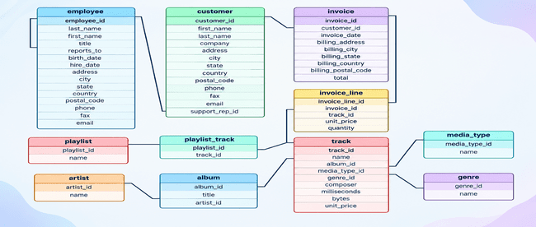
Database Schema

Slide 5
Data Description
customer:
customer_id: Unique identifier assigned to each customer.
first_name: The given name or first name of a customer.
last_name: The surname or family name of a customer.
company: The name of the company associated with a customer.
address: The street address of a customer's location.
city: The city where a customer is located.
state: The state or province where a customer is located.
country: The country where a customer is located.
postal_code: The postal or zip code of a customer's address.
phone: The phone number of a customer.
fax: The fax number associated with a customer.
email: The email address of a customer.
support_rep_id: The employee ID of the support representative assigned to a customer.
invoice_line:
invoice_line_id: Unique identifier assigned to each line item on an invoice.
invoice_id: The invoice ID to which the line item belongs.
track_id: The ID of the track or product included in the line item.
unit_price: The price per unit for the line item.
quantity: The quantity of units for the line item.

Slide 6
Data Description
invoice:
invoice_id: Unique identifier assigned to each invoice.
customer_id: The customer ID associated with the invoice.
invoice_date: The date when the invoice was generated or issued.
billing_address: The street address used for billing purposes.
billing_city: The city used for billing purposes.
billing_state: The state or province used for billing purposes.
billing_country: The country used for billing purposes.
billing_postal_code: The postal or zip code used for billing purposes.
total: The total amount due on the invoice.
playlist:
playlist_id: Unique identifier assigned to each playlist.
name: The name or title of the playlist.
playlist_track:
playlist_id: The ID of the playlist to which the track belongs.
track_id: The ID of the track included in the playlist.
genre:
genre_id: Unique identifier assigned to each genre.
name: The name or description of the genre (e.g., rock, pop, classical).

Slide 7
Data Description
Track:
track_id: Unique identifier assigned to each track or song.
name: The title or name of the track.
album_id: The ID of the album to which the track belongs.
media_type_id: The ID of the media type associated with the track.
genre_id: The ID of the genre associated with the track.
composer: The name of the composer or artist who composed the track.
milliseconds: The duration of the track in milliseconds.
bytes: The file size of the track in bytes.
unit_price: The price per unit for the track.
album:
album_id: Unique identifier assigned to each album.
title: The title or name of the album.
artist_id: The ID of the artist associated with the album.
artist:
artist_id: Unique identifier assigned to each artist.
name: The name of the artist.
media_type:
media_type_id: Unique identifier assigned to each media type.
name: The name or description of the media type (e.g., MPEG audio file, AAC audio file).

Slide 8
Data Cleaning & Preparation
Before initiating the analysis, a preliminary data quality assessment was conducted to identify missing values, duplicate records, and potential inconsistencies. Core transactional fields such as invoice_date, total, track_id, and customer_id were found to be complete and reliable, ensuring the accuracy of sales and customer behavior analysis.
Some optional attributes in the customer table, including state, fax, phone and company, contained missing values. These fields were not critical to the scope of the analysis and were therefore retained without modification.
Duplicate checks were performed using grouping techniques. Repeated entries, such as multiple purchases of the same track within a single invoice, were expected business scenarios rather than data quality issues. Overall, the dataset was well structured

Slide 9


Slide 10
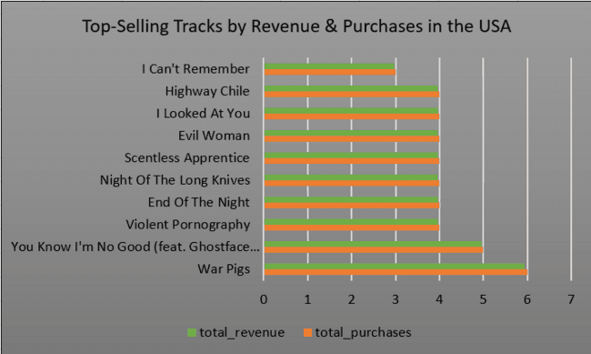
Top-Selling Tracks by Revenue & Purchases in the USA
“War Pigs” generated the highest revenue and
purchase count, making it the top-performing
track in the USA market.
Tracks such as “Highway Chile,” “I Looked
At You,” “Night Of The Long Knives,” and
“Hey Joe” generated almost similar revenue
values customer interest across these songs.
Overall, the chart highlights the most
profitable and frequently purchased tracks
contributing to total sales revenue.

Slide 11
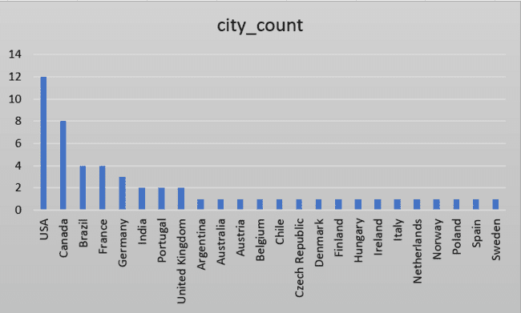
Count of city by country
The USA recorded the highest city count
among all countries, indicating a stronger
customer presence and wider market
coverage.
Canada and Brazil also showed comparatively
higher city counts, reflecting moderate
geographical distribution of customers.
Most other countries contributed only a small
number of cities, showing that customer
activity was concentrated in a few major
countries.

Slide 12
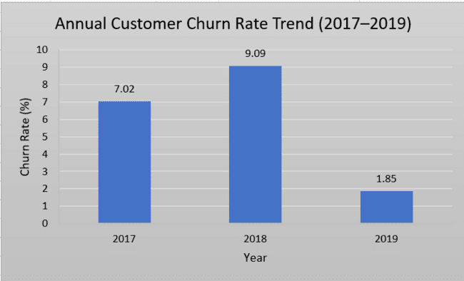
Churn Rate Percentage Analysis
Measures the percentage of active customers who stop purchasing each year.
Churn remained low and dropped sharply from 9.09% in 2018 to 1.85% in 2019.
High customer loyalty and retention across operational years.

Slide 13
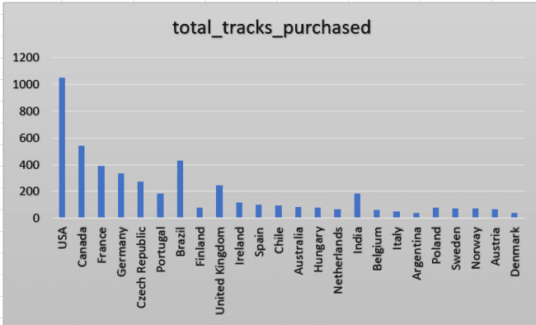
Sum of total_genres_purchased by country
The USA recorded the highest number of
genres purchased, indicating the strongest
customer engagement and music consumption
among all countries.
Canada, France, and Brazil also showed high
genre purchase counts, reflecting diverse
customer preferences and active purchasing
behavior.
Most other countries contributed
comparatively lower genre purchases,
showing that music demand was concentrated.

Slide 14


Slide 15
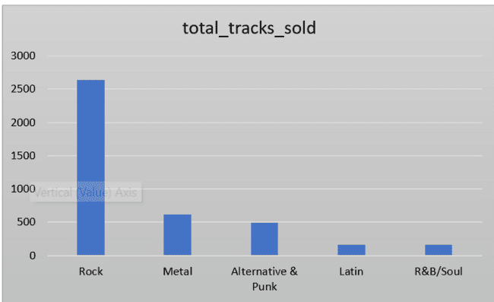
Recommended Albums & Genres
.After analyzing the album and genre sales
performance, I found that Rock genre albums
generated the highest revenue compared to
other music genres.
.I observed that albums like “Are You
Experienced?” and “From The Muddy
Banks Of The Wishkah [live]” achieved the
highest sales revenue .
.The analysis also indicates that although
genres like R&B/Soul and Alternative & Punk

Slide 16
Recommendation of Recommended Albums & Genres
Are You Experienced? (Rock)
  Highest overall performance and strong repeat purchase behavior
  Ideal for primary advertising investment
From the Muddy Banks of the Wishkah (Live) (Rock)
  Consistently high engagement and popularity among Rock listeners
  Suitable for continued promotion and bundling strategies
The Doors (Rock)
  Strong brand recognition and steady sales performance
  Effective for reinforcing Rock-focused marketing campaigns

Slide 17
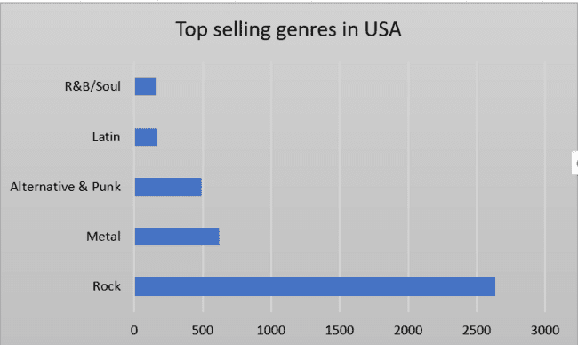
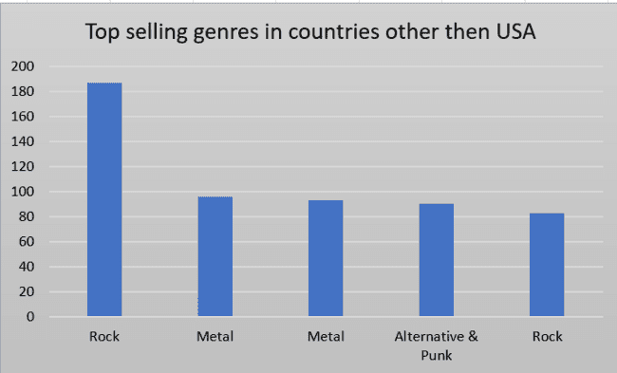

Top Selling Genres in Countries other than USA
The charts show a clear similarity, with Rock
emerging as the top-selling genre in both
the USA and other countries.
In countries outside the USA, Metal ranked
2nd and Alternative & Punk ranked 3rd,
whereas in the USA these positions were
reversed, with Alternative & Punk taking
2nd place and Metal 3rd.
For the 4th and 5th positions, Latin and Jazz
were the leading genres in other countries,
while in the USA those spots were occupied
by R&B/Soul and Blues.

Slide 18
Customer Spending vs Purchase Frequency
The data was divided into Long-term customers (75%) and New customers (25%), and similar trends were observed in average purchase frequency, average basket size, and average total spending for both groups.
All three customer behavior metrics follow a consistent pattern, indicating strong customer retention and loyalty toward Chinook Music Store among long-term customers.
The stable average number of purchases made by customers each year suggests that Chinook Music Store successfully satisfied customer music preferences and maintained their loyalty over time.

Slide 19
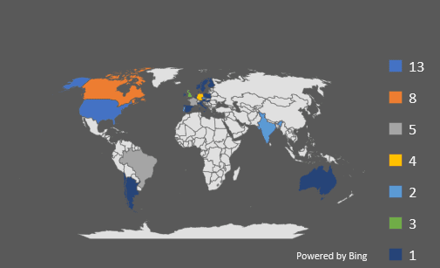
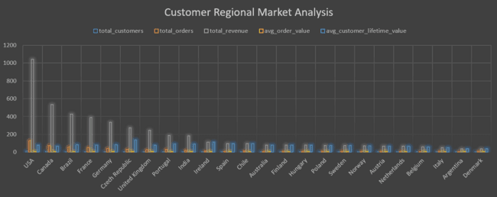
Customer Regional Market Analysis
The USA leads global revenue and order volume. However, smaller European markets like the Czech Republic deliver higher customer lifetime value, indicating strong international expansion potential beyond North America.

Slide 20
Customer Regional Market Analysis
Recommendations
Chinook Music Store should focus on retaining customers in high-churn countries such as Argentina, Austria, Chile, Spain, and the Netherlands through loyalty programs, discounts, and personalized recommendations.
Since the USA generates the highest revenue and orders, the company should continue investing in marketing and premium customer engagement strategies in this region to maximize profitability.
Countries like Canada, France, Brazil, and Germany show strong market potential, so expanding product offerings and targeted promotions in these regions could further increase sales.
USA dominates the market with the highest revenue and total orders, significantly outperforming all other countries.
Canada, Brazil, France, and Germany are the next strongest markets, showing comparatively high revenue and customer activity.
Several countries such as Argentina, Austria, Chile, Spain, and the Netherlands show high churn percentages despite lower customer counts, indicating weaker customer retention.
Countries with lower churn rates like Canada, Czech Republic, Portugal, and Australia demonstrate more stable customer loyalty and retention.

Slide 21
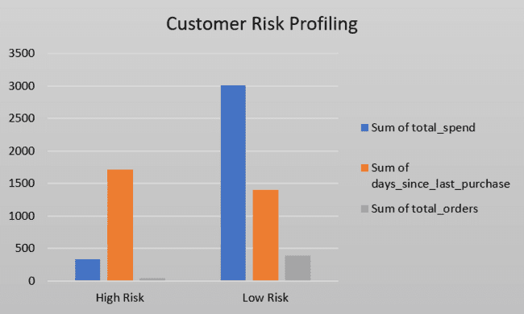
Customer Risk Profiling
Low-risk customers consistently perform better than high-risk customers across all major metrics, including total spending, purchase frequency, and average order value.
Customers in the low-risk segment demonstrate higher average spending (~82.68) and place more orders (~10.93), reflecting stronger engagement and customer loyalty.
High-risk customers exhibit comparatively lower spending (~72.93) and fewer purchases (~9.13), indicating weaker engagement and a greater possibility of churn.
The average order value is also marginally higher among low-risk customers, further highlighting their greater long-term customer value.

Slide 22
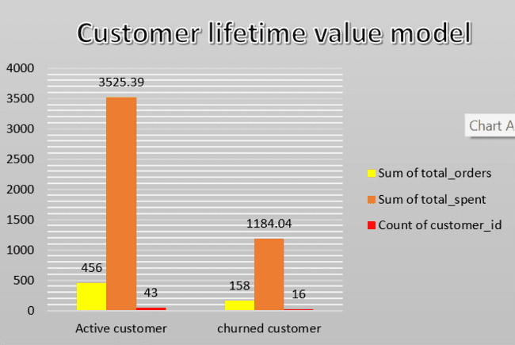
Customer Lifetime Value Model
Active customers generate considerably higher customer lifetime value than churned customers across all major performance indicators.
Customers who remain active exhibit significantly higher total spending (~3525) and a larger number of orders (~456), demonstrating strong engagement and long-term loyalty.
Churned customers show noticeably lower spending (~1184) and fewer total purchases (~158), indicating reduced engagement prior to churn.
The active customer segment also has a larger customer base, emphasizing the critical role of customer retention in maintaining overall revenue growth.

Slide 23
Recommendations
Focus on customer retention strategies, as active and low-risk customers contribute significantly higher revenue and lifetime value.
Implement personalized engagement campaigns, loyalty programs, and targeted offers to maintain customer satisfaction and encourage repeat purchases.
Identify early warning signs of churn by monitoring declining spending patterns and reduced order frequency among high-risk customers.
Develop re-engagement campaigns for churned or inactive customers through discounts, email marketing, and personalized recommendations.
Prioritize high-value customer segments by offering premium services, exclusive rewards, and tailored experiences to strengthen long-term loyalty.
Use predictive analytics and customer segmentation to proactively reduce churn and improve overall customer lifetime value.

Slide 24
Conclusion
The analysis highlights clear trends in customer purchasing behavior, regional performance, and genre preferences, enabling more data-driven and targeted business decisions.
Rock and Alternative genres lead sales across several regions, especially in high-performing countries, indicating strong opportunities for cross-selling and targeted promotions.
Customers with high Customer Lifetime Value (CLV) display consistent engagement and frequent purchasing behavior, making them essential for sustaining long-term revenue growth.
A significant proportion of valuable customers have churned, revealing potential weaknesses in current retention and re-engagement strategies.
Variations in purchasing patterns across regions and customer segments emphasize the importance of implementing segmented and region-specific marketing strategies instead of a one-size-fits-all approach.

Slide 25


